Slide 1
HIMSS
Veterans Career Services Initiative
VCS Program Overview

Slide 2
Overview
Background
Mission
Current Program Offerings
HIMSS15 Annual Conference
HIMSS Career Services

Slide 3


Background
“This workforce solution is 100% funded by an $11.7m grant awarded by the U.S. Department of Labor's Employment and Training Administration. The solution was created by the grantee and does not necessarily reflect the official position of the U.S. Department of Labor. The Department of Labor makes no guarantees, warranties, or assurances of any kind, express or implied, with respect to such information, including any information on linked sites and including, but not limited to, accuracy of the information or its completeness, timeliness, usefulness, adequacy, continued availability or ownership.”

Slide 4
Mission
Create a sustainable system to transition
veterans from military service to civilian
health IT jobs by introducing them to health
IT education and career possibilities in
support of healthcare transformation in the
U.S.

Slide 5
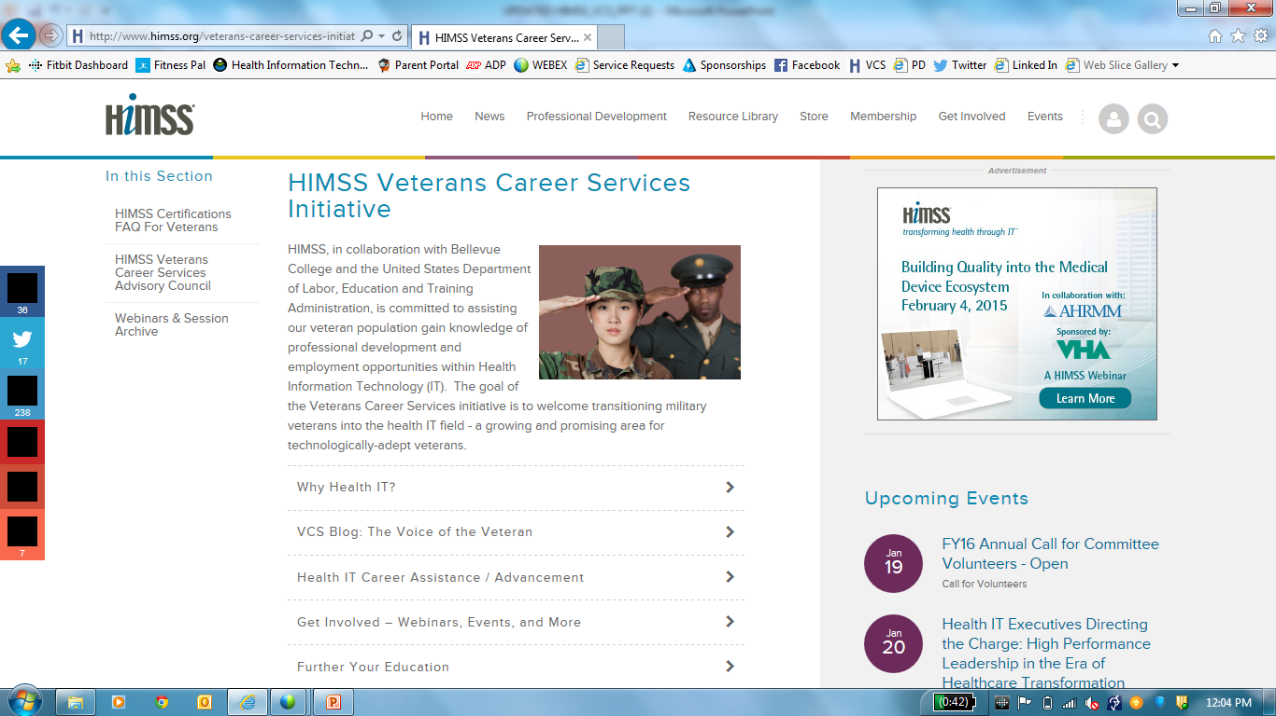
www.HIMSS.org/VCS

Slide 6
Current Offerings
Professional Development
Certifications
Events (HIMSS15, Regional Events, etc)
Monthly Webinars
Collaboration – PD
Career
Support Resources
vMentor
HIMSS Chapters
Collaboration
JobMine®

Slide 7
HIMSS15
www.himssconference.org
Complimentary Registration
  HIMSS Chapter Travel Honorariums
HIMSS VCS Career Boot Camp
  http://www.himssconference.org/education/veterans-career-boot-camp/
Hero’s Welcome to Healthcare IT Booth
  http://www.himssconference.org/career/veterans-services

Slide 8
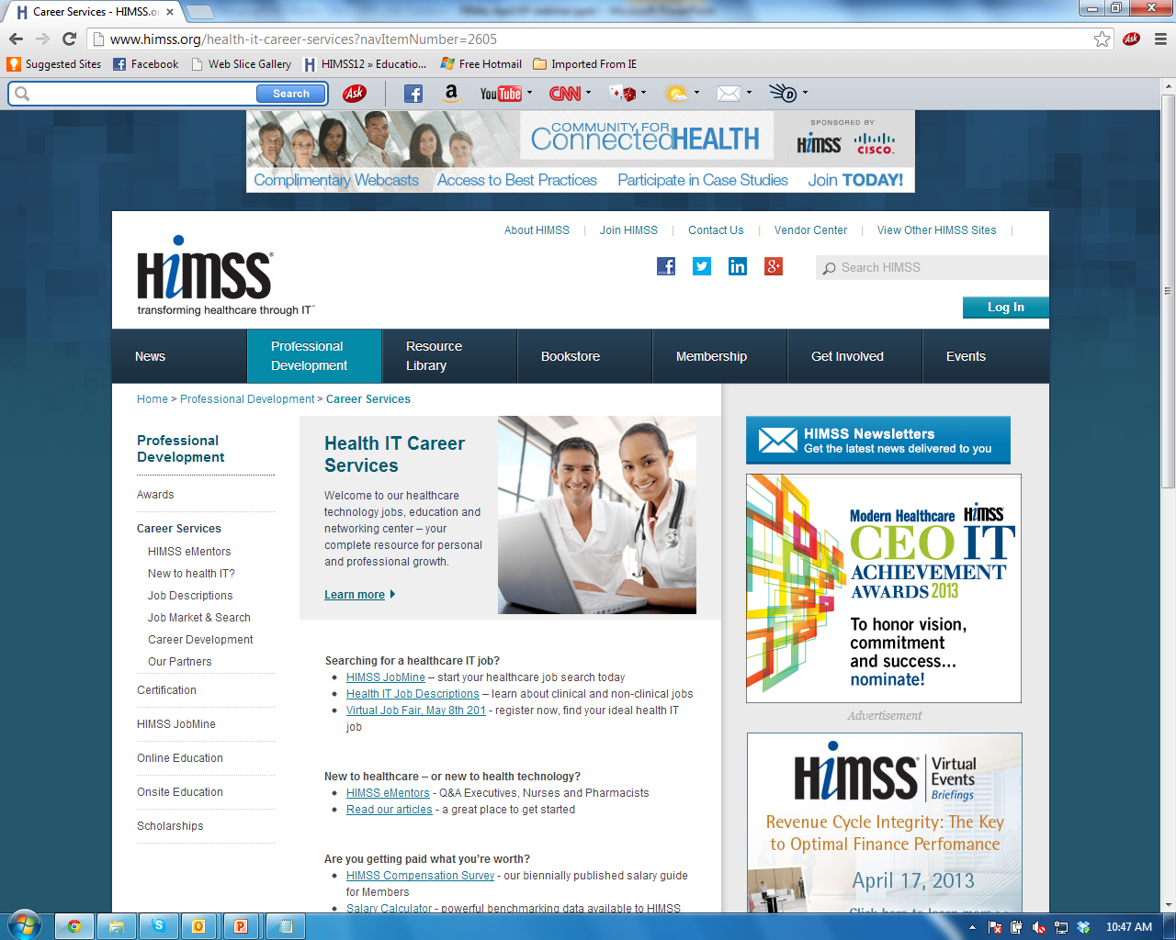
HIMSS Career Services
Advancement
Awards Program
CAHIMS/CPHIMS
Emerging Professionals Community
HIMSS JobMine®
Monthly webinars
Scholarships
http://www.himss.org/health-it-career-services?navItemNumber=2605

Slide 9

Contact Information
Amy R. Justice, MBA, MSgt (USAF retired)
Program Manager, Veterans Career Services
HIMSS
Email: ajustice@himss.org
Phone: 312-448-3428
Twitter: @AjusticeX
Notes:
Add a little about myself if time permits….

